Slide 1
GENERAL CHARACTERS OF PHYLUM ONYCHOPHORA
PRESENTED BY :-
S.K. MANHAI

Slide 2
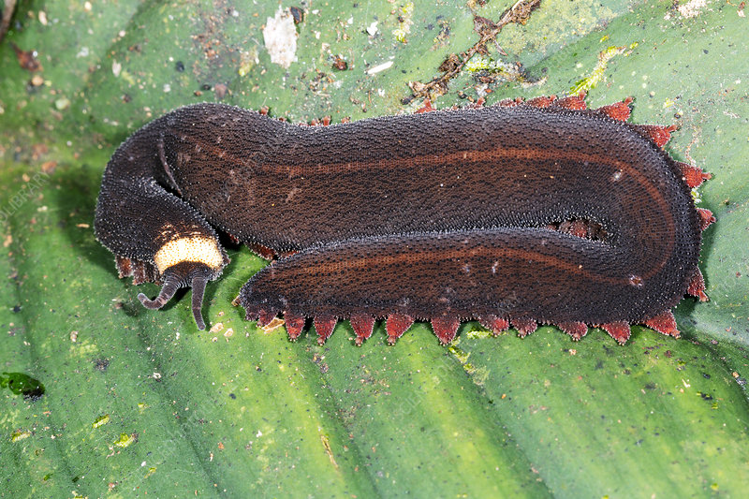

Slide 3
ONYCHOPHORA :- Onyx – claw , pherein – bear .
It was conventionally classified with arthropoda as one of its classes . But the modern system animal classification has given to it the status of an independent phylum .
There are about 70 species in this phylum belonging to a few genera or possibly to one genus ,peripatus .

Slide 4
Geographical distribution
It exhibits discontinuous distribution with its species scattered in most of the warmer parts of the world – Africa, Australia , New Zealand , Central America ,Mexico ,West indies , Malaya Archipelago , India and other localities .

Slide 5
Habit and Habitat
Peripatus is a terrestrial animal, living in moist places ,in crevices of rocks , under stones , logs and bark , and other dark and damp places where it is protected both from loss of water and also from predatory arthropods .

Slide 6
External morphology
Body is elongated , cylindrical and bilaterally symmetrical , measuring between 5 -7 cm in length .
The external segmentation is unclear and the legs ,which number from 14 to 43 pairs , unjointed .
Each legs is stumpy protuberance ending in two claws and provided with 3 to 6 pads on ventral side which serves as walking soles which contact the substratum

Slide 7
Anatomical features
The body wall is dermo- muscular , consisting of cuticle , epidermis , dermis , and striped circular and longitudinal muscles.
The coelom is in the form of small cavities around gonads and metanephridia .
The body cavity is a haemocoel , lined with epithelium .

Slide 8
A pair of slime glands are located , one on either side of the body cavity . These open on the oral papillae and secrete an adhesive slime for entangling the prey .
The mouth leads into alimentary canal , which comprises of a tongue with rows of sensory spines , muscular pharynx into which opens a pair of large salivery glands , short foregut or oesophagus , long midgut or stomach – intestine and short hindgut or rectum .

Slide 9
The respiratory organs are unbranched trachea , communicating to outside through minute spiracles .
The excretory organs are coxal glands, one pair in each segment ,opening at the base of the legs .
A dorsal tubular contractile heart lies within the pericardial cavity .

Slide 10
The nervous system consists of a pairs of suprapharyngeal ganglion or brain with two circumpharyngeal connectives and a pair of widely separated lateral longitudinal nerve cords connected together by transverse commissures . Ganglion on the cords are indistinct .
Sensory organs are a pair of eyes near the base of the antennae ,taste spines on the lips and preoral cavity and tactile spines on the surface tubercles .

Slide 11
Female reproductive organs include a pair of ovaries ,a pair of oviducts and a pair of beaded uteri . The uteri join to open to outside through a vaginal opening . The male reproductive system has paired testes , seminal vesicles ,vasa diferential and genital opening.
Fertilization internal . the female produces about 30 or more young in a year . The young resembles to the adult .

Slide 12
Thanks you

