Slide 1
B.Sc. 4th Semester (Honours)
Subject- Zoology
Topic Name: Respiratory Pigments
Name of the teacher: Dr. Merina Narah
Assistant professor
Department of Zoology
Silapathar College, 787059

Slide 5
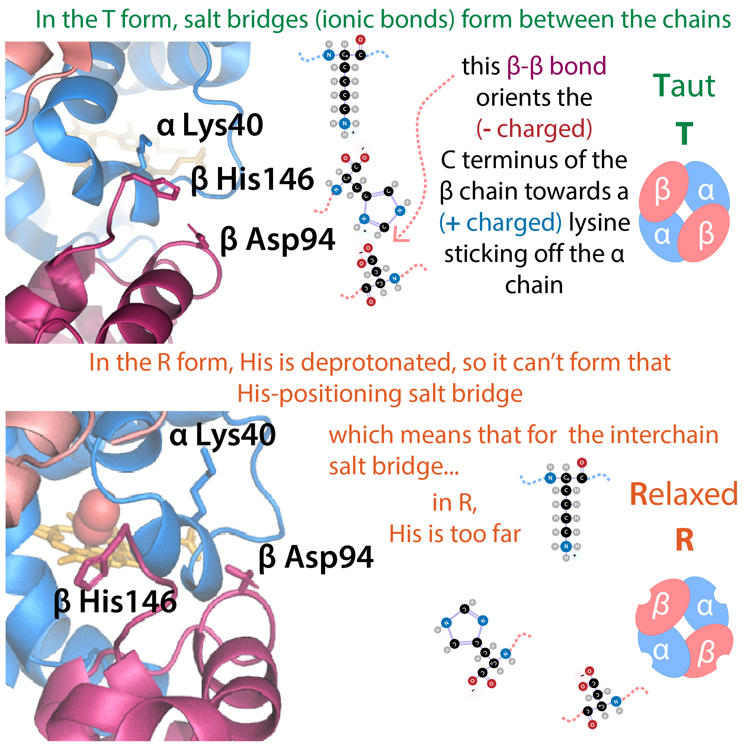

Slide 6
Thanks

