Slide 1
B.Sc. 4th Semester (GE)
Biomedical Waste
Dr. Merina Narah
Asstt. Prof., Dept. of Zoology
Silapathar College

Slide 2
What is Biomedical Waste?
“Any waste which is generated during the diagnosis, treatment or immunization of human beings or animals or research activities pertaining there to or in the production or testing of biological or in health camps, including the categories mentioned in Schedule I appended to Biomedical Waste Management rules 2016” – World Health Organization

Slide 5
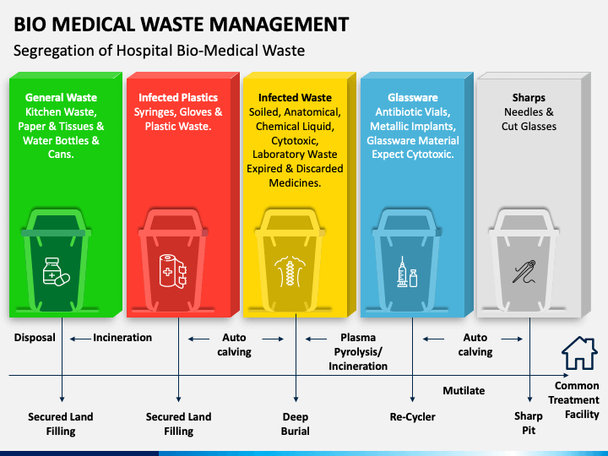

Slide 6
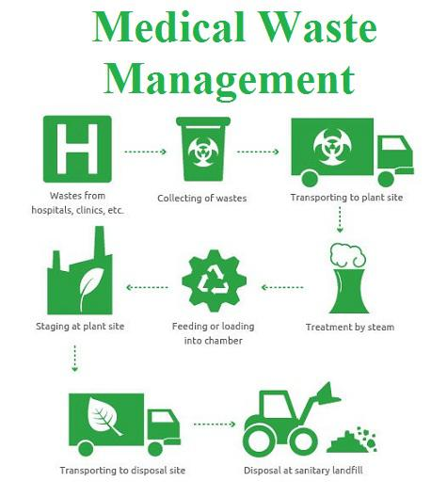

Slide 8
Thanks

