Slide 1
INDO-CHINA RELATIONSHIP
B.A. 6TH SEMESTER (H)
PAPER: DSE 4A

Slide 2
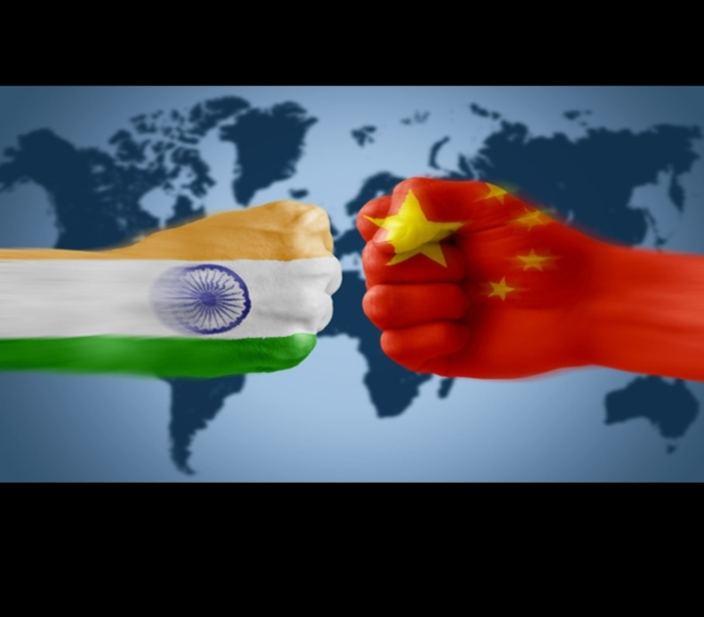
BACKGROUND OF THE RELATIONSHIP
Two Asian giants.
Both countries are having highest globalpopulation record.
Both India and China are two of the world’s most ancient civilization.
Buddhism has been the linking religion.

Slide 3
Inside the Story
Indo-China Relationship
Modern
Areas of Co-operation
Areas of Conflict
Ancient
Areas of Co-operation

Slide 4
Indo-China Relationship in Ancient Period
During ancient times, despite no political contact, there were significant cultural contacts between the two countries.
Buddhism, which originated in India and Spread to China was an important cultural link.
The Indian Buddhist monks, Kashyapa Matanga and Dharmaratna went to China in 65 AD.
The Tang Dynasty of China played an important role in promoting Buddhism in the country.
Many Chinese Buddhist scholars like Fahein, Hiuen Tsang, Yiding came to India at different times.
Chinese travelers introduced silk, vermilion etc. to India.
Economic exchanges between the two civilisation took place through the old silk route. (ancient trade route).

Slide 5
Indo-China Relationship in Modern Period
Contact between India and China was reestablished during the late 18th century/early 19th Century.
The great Indian poet Rabindra Nath Tagore visited China in 1924.
A five member medial mission was sent to China during the Second Sino-Japanese(1937-1945).
China merged as a new nation in 1949 under the leadership of Mao Tse Tung.
In 1954, the five principles of Panchasheel came into existence between the two neighbours.
The same year, Chinese Premier Zhou Enlai visited India in June and Nehru made a trip to China in October.

Slide 6
Indo-China Relationship in Modern Period
But Indo-China War 1962 was a rude shock to Nehru and major setback to bilateral relations.
Relationship was restored with Atal Bihari Vajpayee’s visit to China in 1978.
The relationship got a boost during the historical visit of Rajiv Gandhi to China in 1988.
China and India adopted ‘structural adjustment policy’ (economic liberalization) in 1979 and 1991 respectively.

