Slide 1
Global Politics
Unit 3: Global Issues-I
Topic: Proliferation of Nuclear Weapons
B.A. 4th Semester (H)

Slide 2
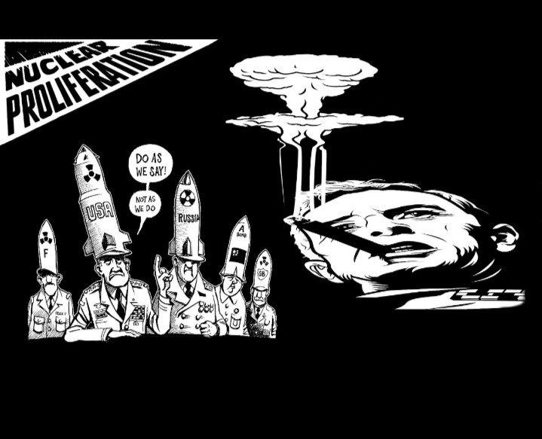
Proliferation of Nuclear Weapons
the spread of nuclear weapons, nuclear weapons technology, or fissile material to countries that do not already possess them.
The term is also used to refer to the possible acquisition of nuclear weapons by terrorist organizations or other armed groups

Slide 3
Nuclear Proliferation and the Great Powers
The origin of nuclear era can be traced back to 6th and 9th August respectively when the United States dropped two atomic bombs on the Japanese cities of Hiroshima and Nagasaki respectively.
The Soviet Union exploded its hydrogen bomb in 1949.
The United Kingdom and France entered the nuclear hub in 1952 and 1960 respectively.
Not to be left out, China too exploded a nuclear bomb in 1964.

Slide 4
Look at the Chart
COUNTRY | Year of First Nuclear Test
USA | 1945
RUSSIA | 1949
UK | 1952
FRANCE | 1960
CHINA | 1964
INDIA | 1974
PAKISTAN | 1998

Slide 5
Vertical Vs. Horizontal Proliferation
Vertical proliferation refers to incremental additions of a particular weapons system by a state or a number of states that already posses the weapons.
Increases arms race.
Horizontal Proliferation refers to the spread of nuclear weapons and other weapons of mass destruction to states that do not possess them presently but have already developed capability of manufacturing nuclear weapons.

Slide 6
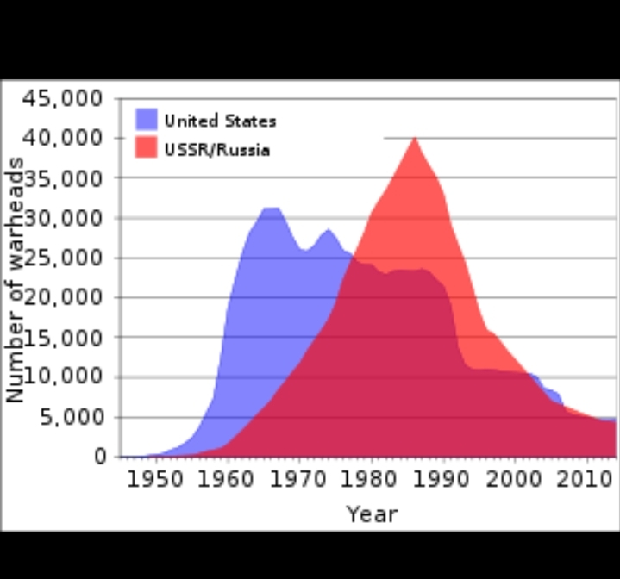
Statistics Says……..

Slide 7
Total Nuclear Warheads- 14,000 (estimated)
US & RUSSIA- 12, 600+
COUNTRY | WARHEADS
NORTH KOREA | 30
ISRAEL | 90
INDIA | 140
PAKISTAN | 160
UK | 200
CHINA | 290
FRANCE | 300
USA | 6185
RUSSIA | 6490

Slide 8
“AXIS OF EVIL”
Iraq, Iran, Syria, Libya and North Korea.
The term was coined by George Bush under ‘Bush Doctrine.’

