Slide 1
Indo-US Relation
B.A. 6th Semester
DSE 4A
India’s Foreign Policy in a Globalizing World

Slide 2
Indo-USA Relationship in Cold War Era
Relationship characterized by cold war strategic parameters.
USA led capitalist block against Soviet Union communist block.
India followed NAM.
Socialist economy of India having soft corner towards Soviet Union.
But, USA initiated PL-480 Food Assistance Programme.
Sympathetic to India during Indo-China conflict.
Indo-Soviet Treaty of Peace, Friendship and Co-operation, 1971 created confusion and mistrust in the relationship.
USA supported Pakistan in 1971 war.

Slide 3
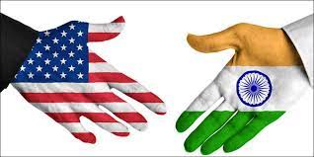
Background of the Indo-USA Relationship
India is the world’s biggest democracy whereas USA is often regarded as the world’s oldest democracy.
They abide by the rule of law, have federal political structure and independent judiciary.
Multicultural and multiethnic societies.
Yet relationship has been characterized by many ups and down.

