Slide 1
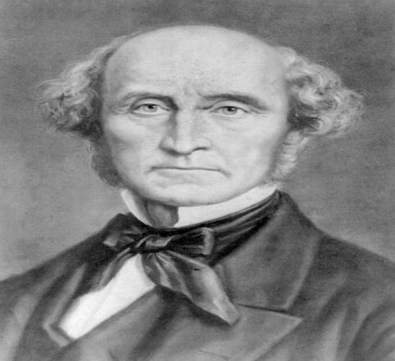
Liberal Socialist
JOHN STUART MILL ON LIBERTY
Presented by:-
Nabin Chandra Kardong
HoD & Associate Professor,
Dept. of Political Science,
Silapathar College, Silapathar.

Slide 2
INTRODUCTION
John Stuart Mill (1806 – 1873) was an English Philosopher, Political Economist, Member of Parliament (MP) and Civil Servant.
His substantial corpus of works includes texts in logic, epistemology, economics, social and political philosophy, ethics, metaphysics, religion and current affairs.
Among his most well-known and significant are –
i) A system of Logic
ii) Principles of Political Economy
iii) On Liberty
iv) Utilitarianism
v) The Subjection of Women
vi) Three Essays on Religion.

Slide 3
J.S. MILL ON LIBERTY
Mill clarified and detailed his position on liberty by defending three specific liberties as discussed below –
1) Freedom of Speech and Expression:
a) Freedom of free speech:- On liberty involves an impassioned defense of free speech. Mill argues that free discourse is a necessary condition for intellectual and social progress.
Harm Principle:- The belief that freedom of Speech or if any argument is really wrong or harmful, the public will judge it as wrong or harmful and then those arguments cannot be sustained and will be excluded.
b) Freedom of the Press:- In On liberty, Mill thought it was necessary for him to restate the case for press freedom.

Slide 4
2) Liberty of Action:
Mill divided Liberty of Action as Self Regarding and Other Regarding Actions.
There are those actions which concerned only the individual performing as self-regarding actions and those actions which affect others or other-regarding actions.
3) Liberty of Association:
Mill defended liberty of association on three grounds.
i) When the thing to be done is likely to be done better by individuals than by government.
ii) Allowing individuals to get together to do something, even if they do not do it as well as the government might have done it, is better for the mental education of these individuals.
iii) If we let the government to do everything, there is the evil of adding unnecessarily to its power.

Slide 5
Mill’s Doctrine of Individual’s Liberty of Conduct
Mill’s doctrine of the individual’s liberty of conduct may be summarized under three heads:
The advocacy of the due recognition of the place and importance of impulse and desire in man, as distinguished from intellect, though in close connection with it – the “supreme need of amply acknowledging the active and energetic side of the individual’s nature”;
Insistence on the view that spontaneity or individuality is a necessary ingredient in happiness or human welfare; and
Revolt against the conventionalities of society that hinder, or seem to hinder, the development and expression of individuality – against the despotism of social custom.
******

Slide 6
THANKS

