Slide 1
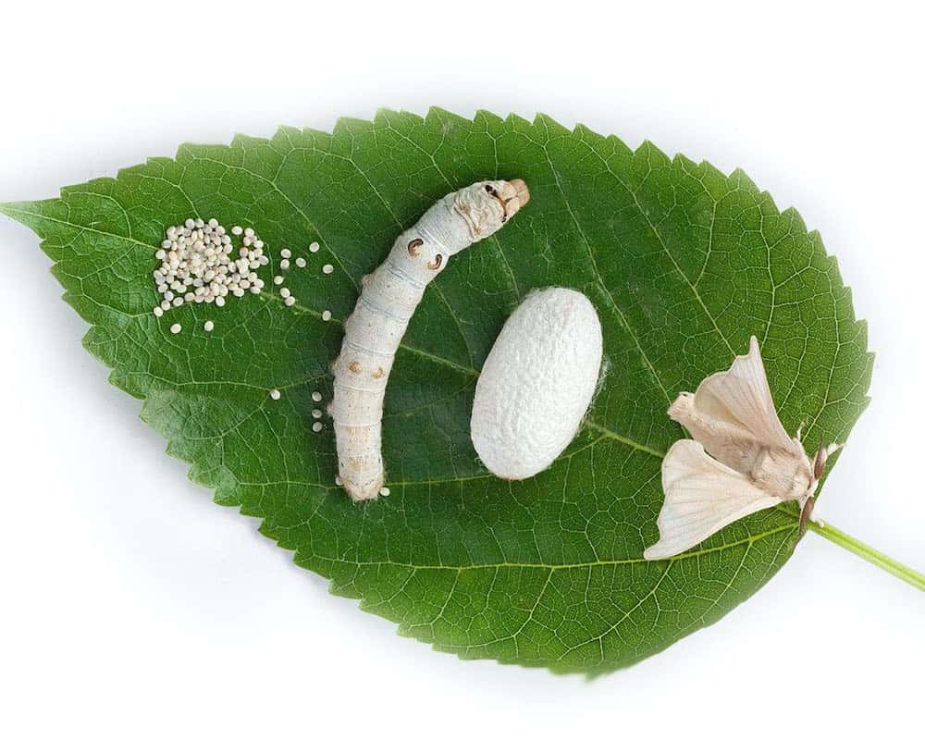
SEC-III: SERICULTURE
B.Sc. 4th Sem Zoology (Hons.)
Topics: Definition
History
Present Status
Silk route
Types of Silkworms
Name of the Teacher:- Saimoun Ken Manhai
Dept. of Zoology
Silapathar College
Silapathar

Slide 4
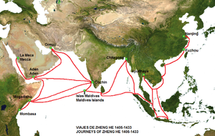
Silk route-
The silk route was a historic trade route that dated from the second century B.C. until the 14th century A.D. It stretched from Asia to the Mediterranean, traversing China, India, Persia, Arabia, Greece and Italy. It was dubbed the silk route because of the heavy silk trading that took place during that period

Slide 5
Different types of Silkworms
There are five major types of silkworm for commercial importance
Mulberry silkworm
Tasar silkworm
Oak tasar silkworm
Eri silkworm
Muga silkworm

