Slide 1
GOODNESS OF FIT (R²)
Prepared by
Anindita Chakravarty

Slide 2
GOODNESS OF FIT
A measure of goodness of fit is the square of the correlation coefficient ( R² ), which shows the percentage of the total variation of the dependent variable that can be explained by the independent variable (x).

Slide 3
NOTE: TSS= ESS+RSS
TSS: Total Sum of Squares
ESS: Explained Sum of Squares
RSS: Residual Sum of Squares
Now, R² = ESS
TSS
Since ESS= TSS-RSS
Therefore, R² = TSS-RSS
^{TSS}

Slide 4
Properties of R²
It is a non-negative quantity R² ≥ 0. It is calculated with the assumption that there is an intercept term in the regression equation of Y on Xs.
Its limits are 0 ≤ R² ≤ 1.
When its 0: There is no relationship between the dependent and independent variable.
^{When} its 1: There is perfect relationship.
3. R² = r²
^{The correlation coefficient} ^{lies between -1 and +1.}
-1 : perfect negative correlation
+1: perfect positive correlation

Slide 5
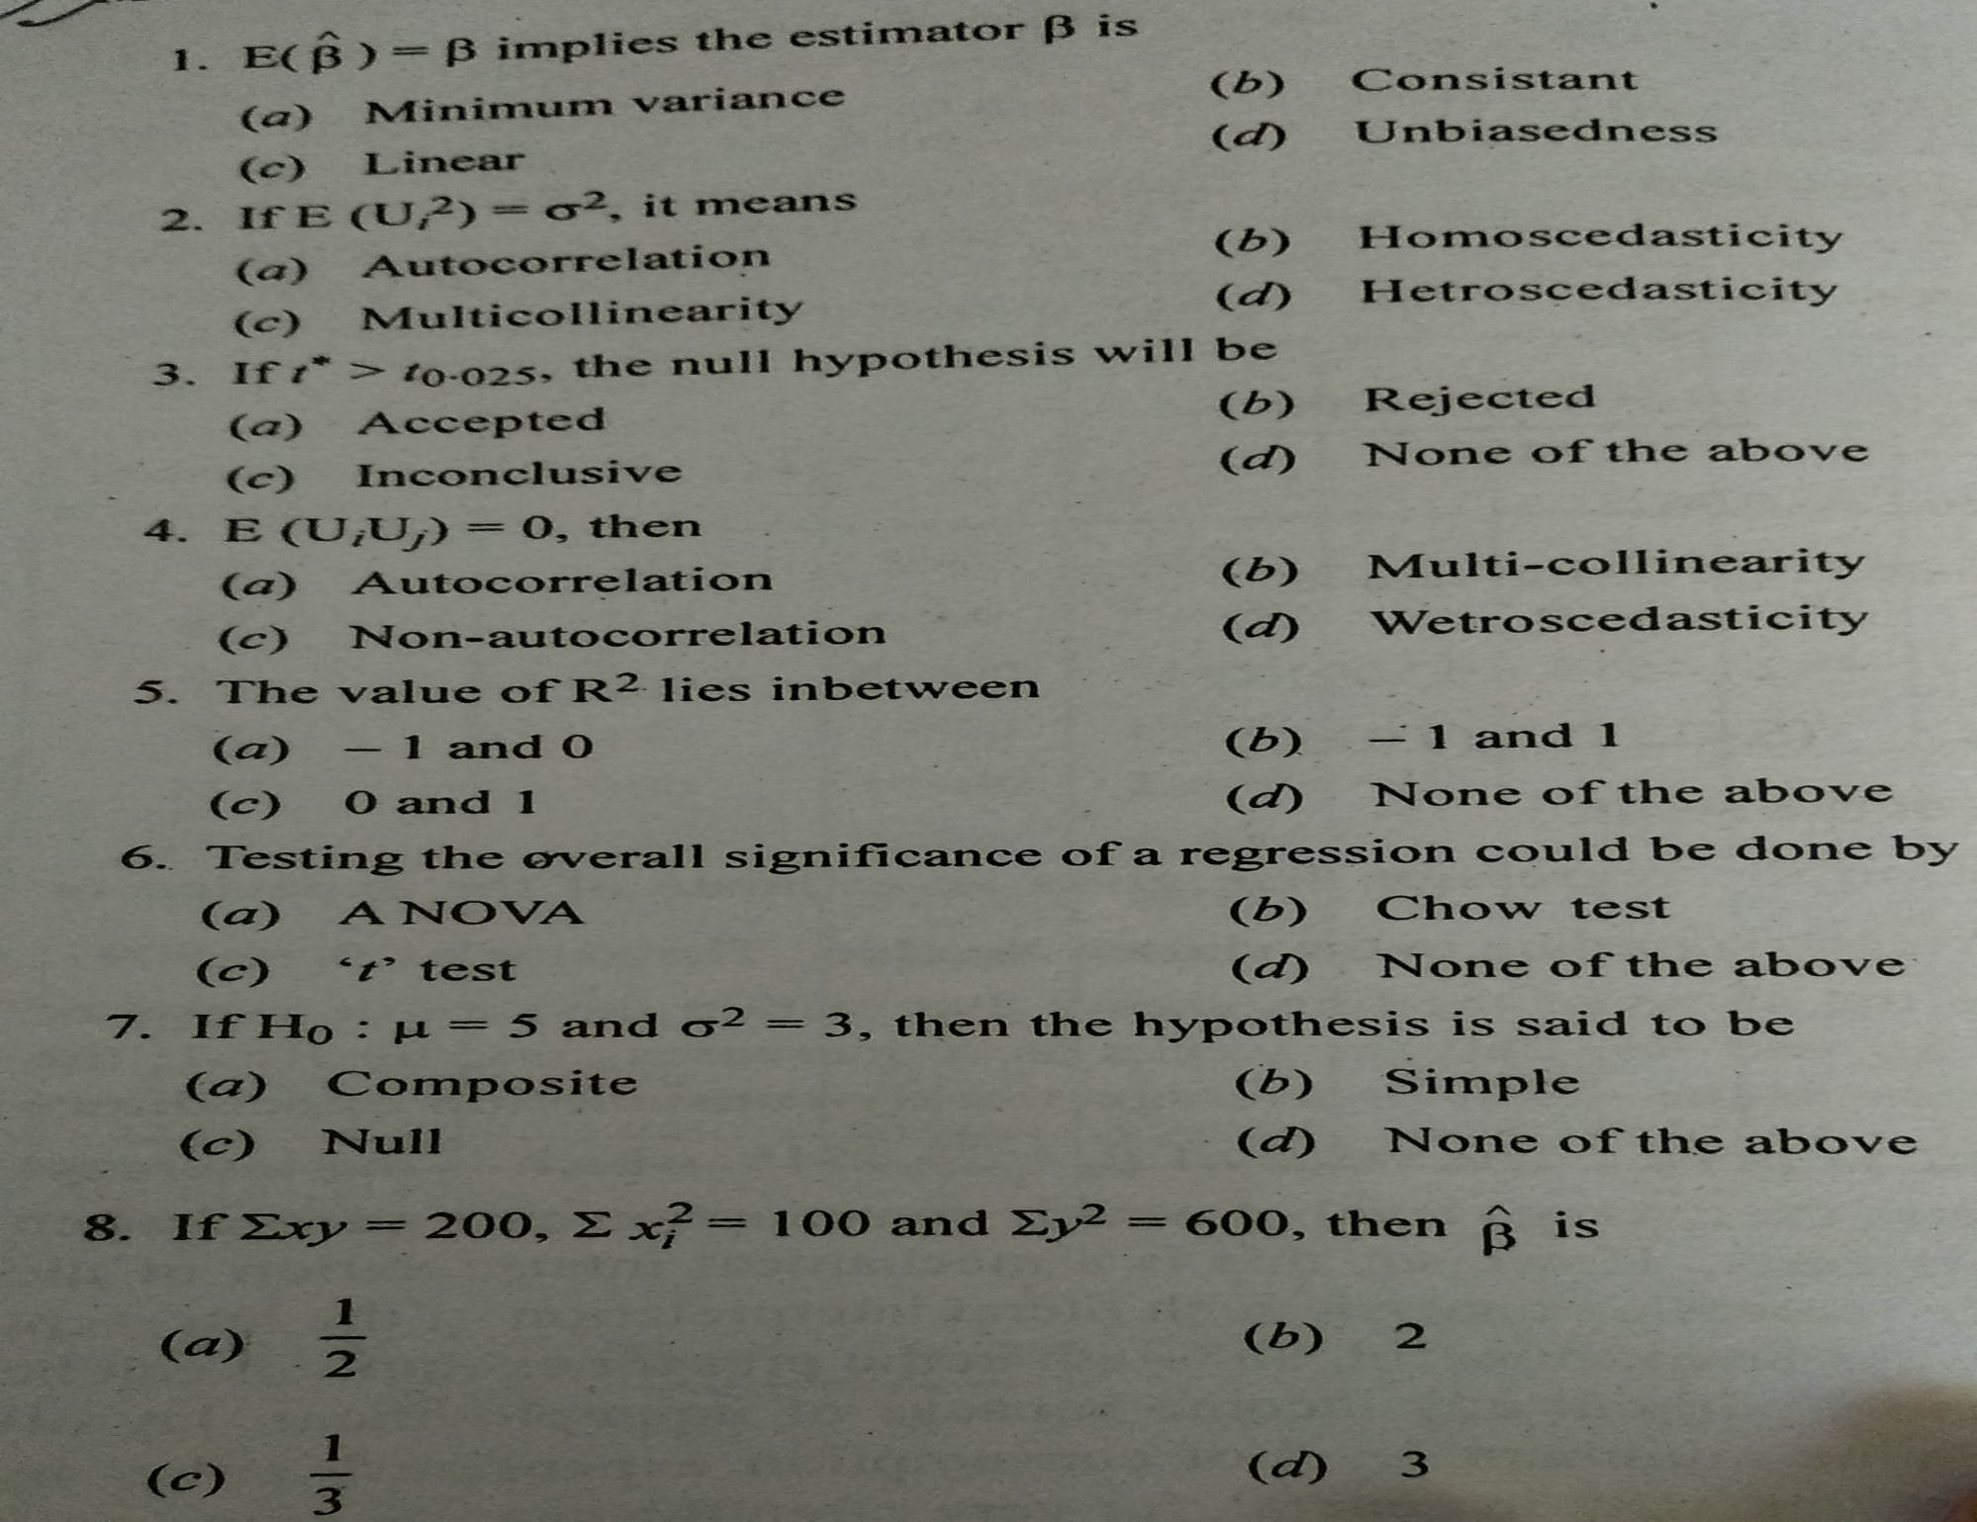

Slide 6
THANK YOU

