Slide 1
The World Bank
B.A. 4th Semester
Paper: Global Politics

Slide 2
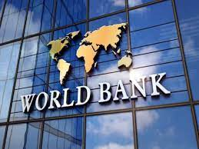
World Bank-At a Glance
An International Financial Institution that provides loans and grants to the governments of low and middle income countries.
Formation: July, 1944.
Motto: Working for a World free of Poverty.
Headquarter: Washington D.C., USA.

Slide 3
World Bank as a Component of World Bank Group
International Bank for Reconstruction and Development (IBRD).
International Development Association (IDA).
International Finance Corporation (IFC).
Multilateral Investment Guarantee Agency (MIGA).
International Centre for Settlement of Investment Disputes (ICSID).

Slide 4
Structures
President of World Bank (Tenure: 5 Years)
Usually from USA or from a country from its choice
Board of Governors
Policy Making Body; Weightage Voting

Slide 5
Functions
Granting reconstruction loans to war devastated countries.
Granting developmental loans to underdeveloped countries.
Providing loans to government for agriculture, irrigation, power, transport, water supply, education, health, etc.
Providing loans to private concerns for specified projects.
Providing technical, monetary and economic advice to member countries for specific projects.

Slide 6
Contributors Vs Borrowers
Top Contributors
Top Borrowers
USA.
Japan
Germany
UK
France
Mexico
Brazil
Turkey
Pakistan
China
India
Argentina

