Slide 1
4th Semester
UNIT: 2
BLUE PROPERTIES OF ESTIMATORS
BY Anindita Chakravarty

Slide 2
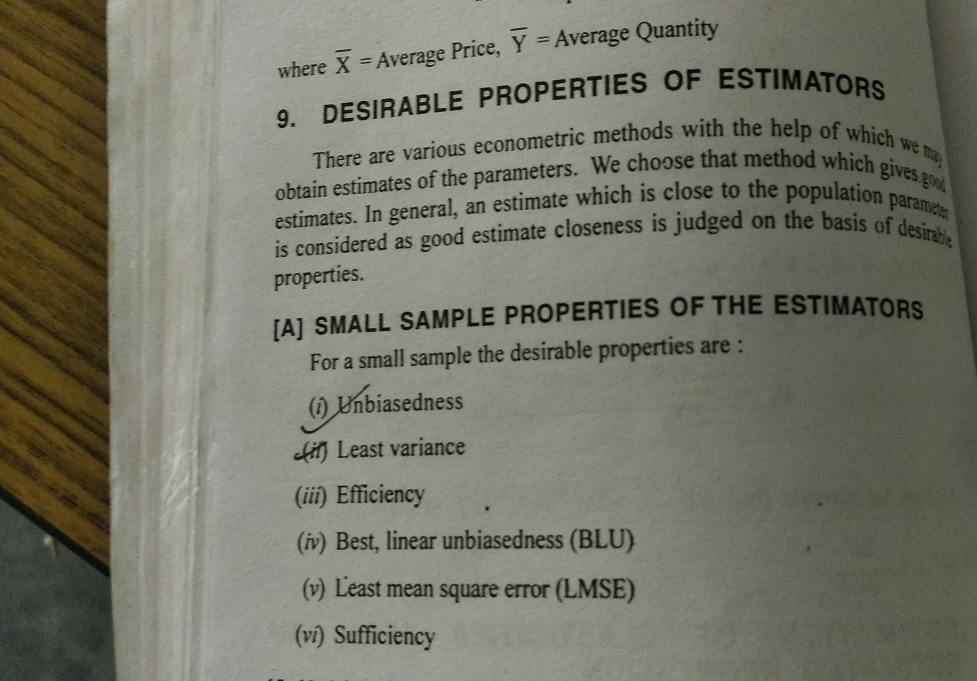

Slide 3
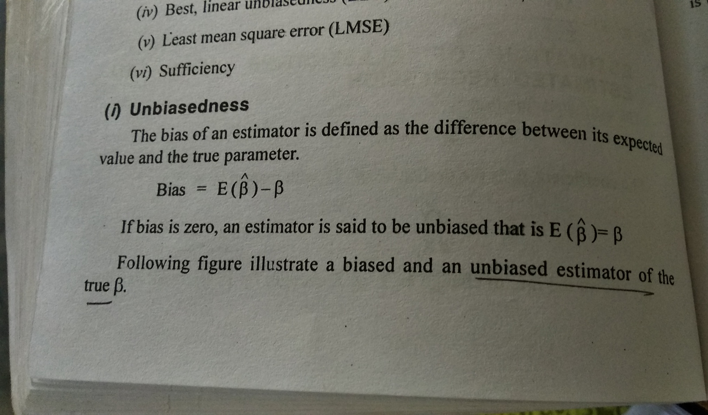

Slide 4
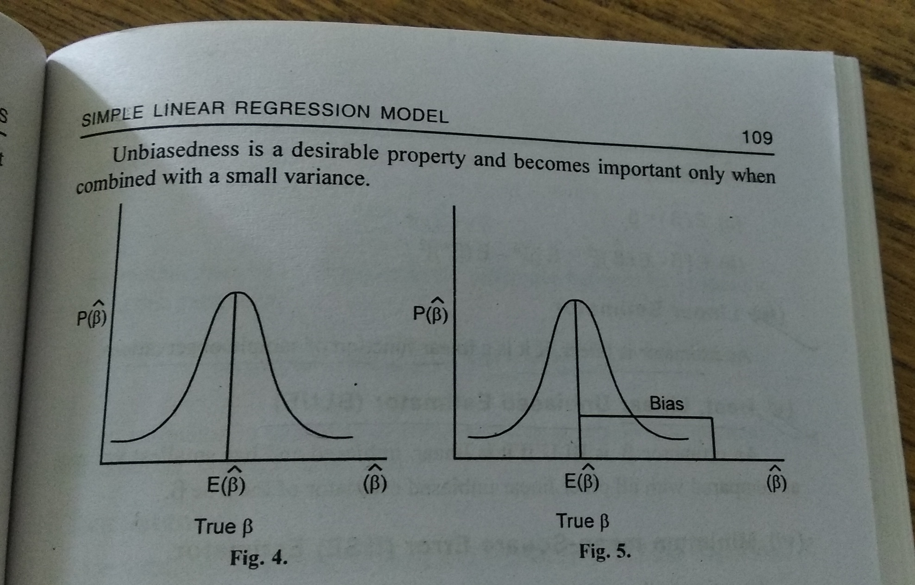

Slide 5
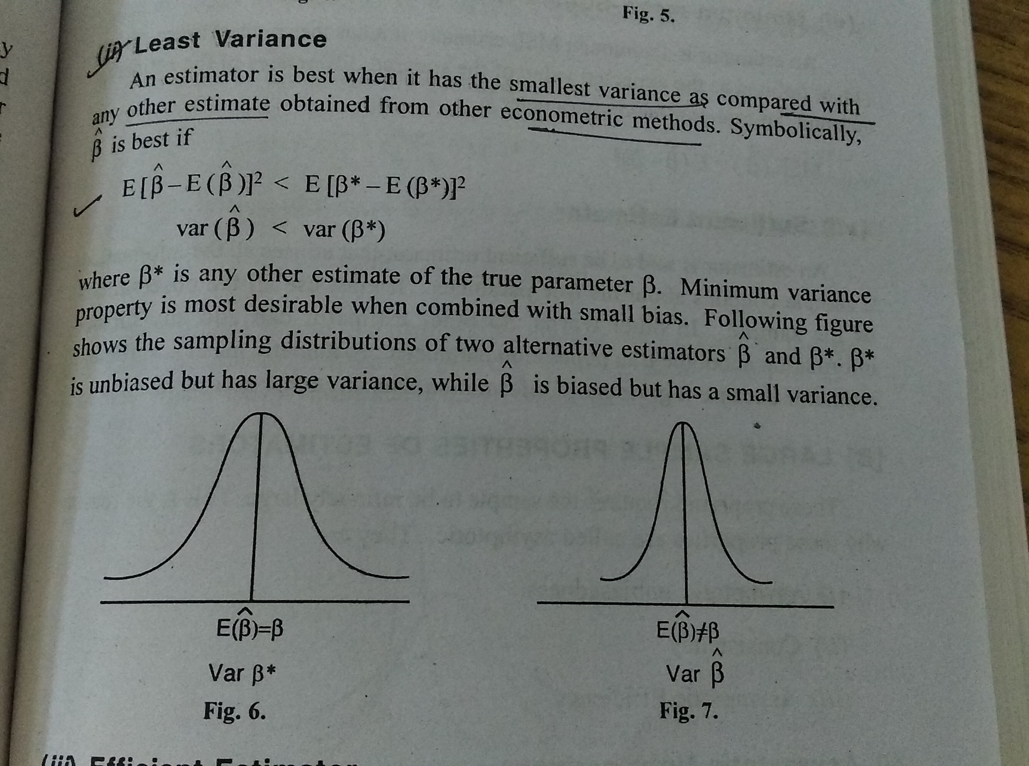

Slide 6
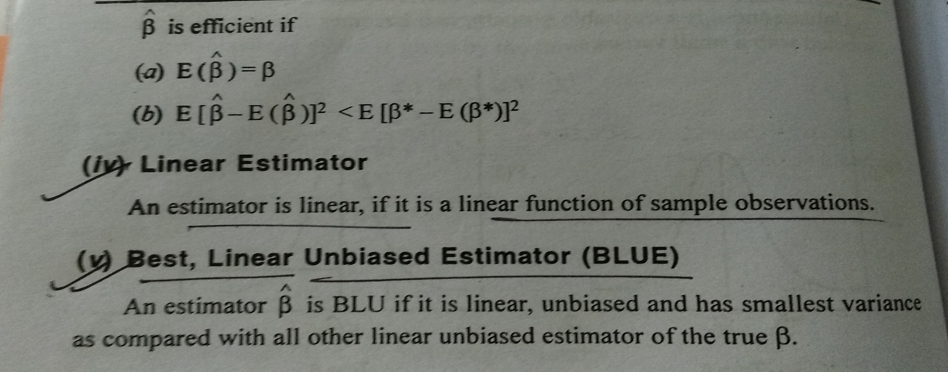
Efficient Estimator:
An estimator is efficient when it possess both the previous properties as compared with any other unbiased estimator.

Slide 7
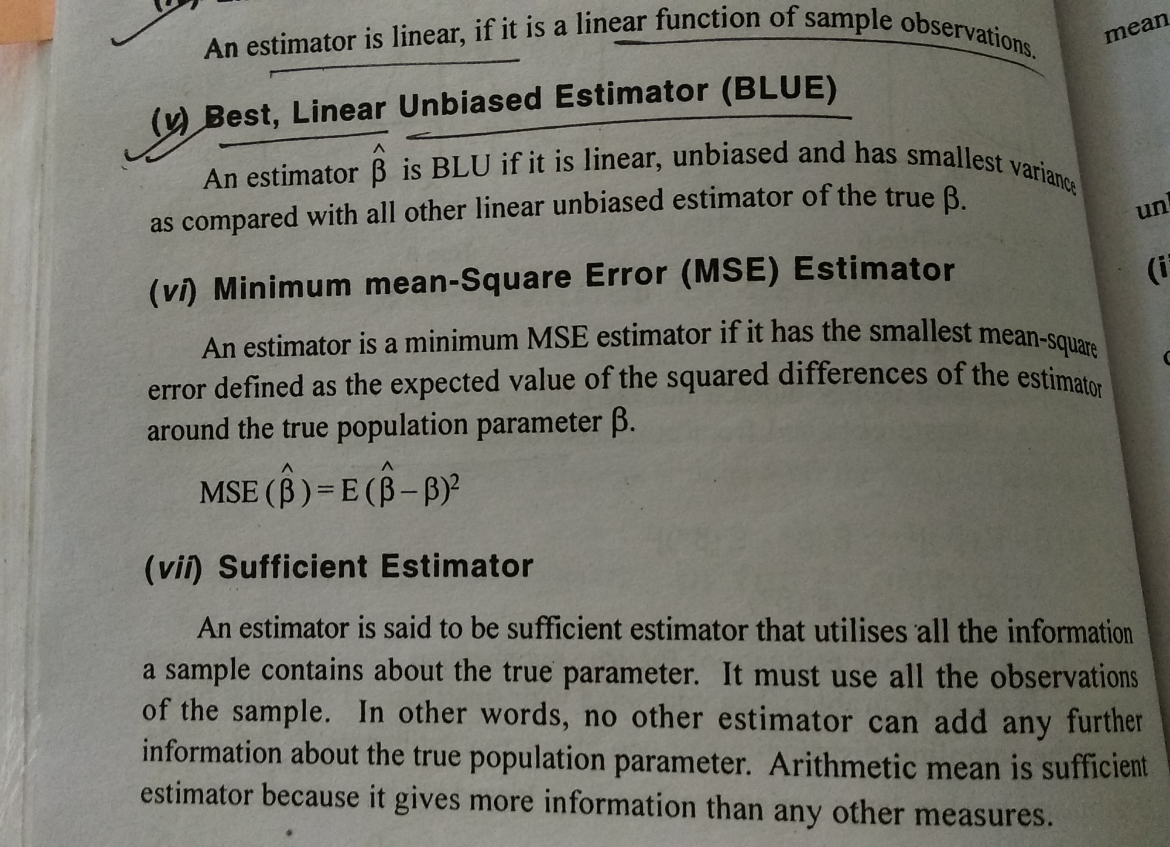

Slide 8
THANKS

