Slide 1
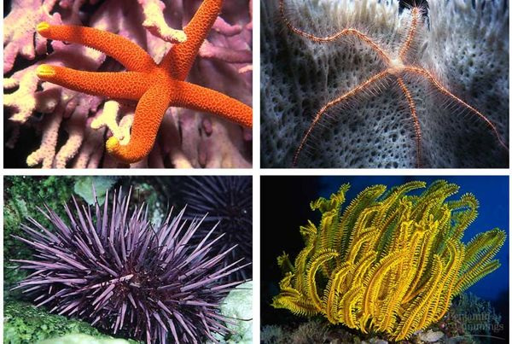
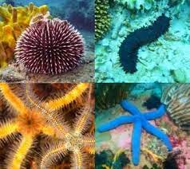
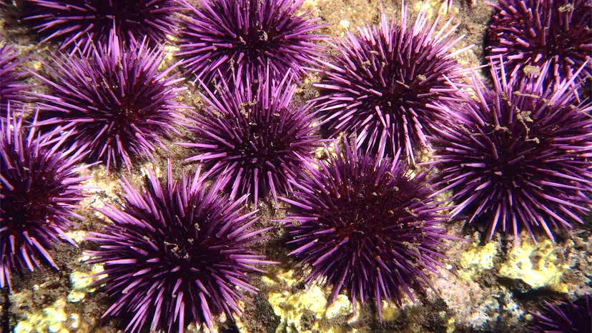
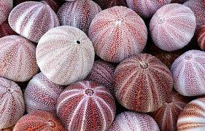
B.Sc. 2nd Sem (Honours)
Subject: Zoology
Paper: ZC-203T
Topic:
General Characters and Classification of Echinodermata
Dr. Merina Narah
Assistant Professor
Dept. of Zoology
Silapathar College
Silapathar, 787059, Assam.

Slide 2
General Characters of Phylum- Echinodermata:-
The echinoderms are exclusively marine.
They occur in all seas from the intertidal zone to the great depths.
They possess radial symmetry.
Body is triploblastic, coelomate with distinct oral and aboral surfaces.
Body shape rounded or cylindrical or star-like.
Presence of water vascular system or ambulacral system is the most characteristic feature.
Circulatory or haemal or blood lacunar system is typically present.
Nervous system is primitive.
Sense organs are poorly developed.
Sexes are separate (dioecious) with few exceptions.
Reproduction is usually sexual, few reproduce asexually or by regeneration.
Development involves larval stages which undergo metamorphosis.

Slide 3
5 different classes of Phylum Echinodermata
Feather- Star

Slide 4
Table: 1

Slide 5
Thank you

