Slide 1
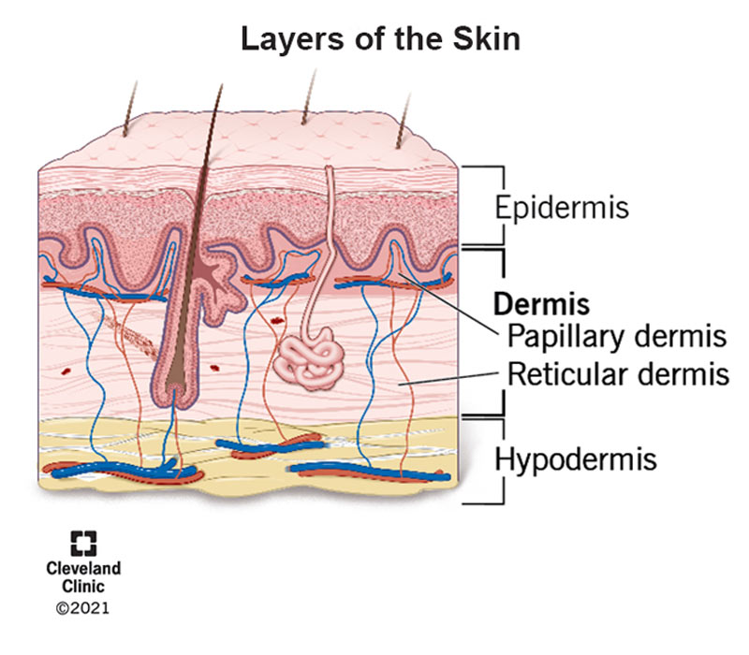
DERMIS OF SKIN
Mr. saimoun ken manhai

Slide 2
Dermis is made of fibrous connective tissue that contains arterioles for supplying nutrients ( oxygen , glucose, water and ions)to its structures and to the epidermis .
It also contains arrector pili muscles (made of skeletal muscle ,under involuntary control )to wrinkle the skin and erect the hairs.
It also contains nerves and nerve receptors to detect the sensation of heat , cold, pressure ,touch and pain.
It contains hairs follicles to develop the hair.

Slide 3
It contains sebaceous glands to secrete sebum onto skin surface and sudoriferous glands to secrete sweat.

Slide 4
