Slide 1
Ozone layer depletion
Prepared by anindita Chakravarty

Slide 2
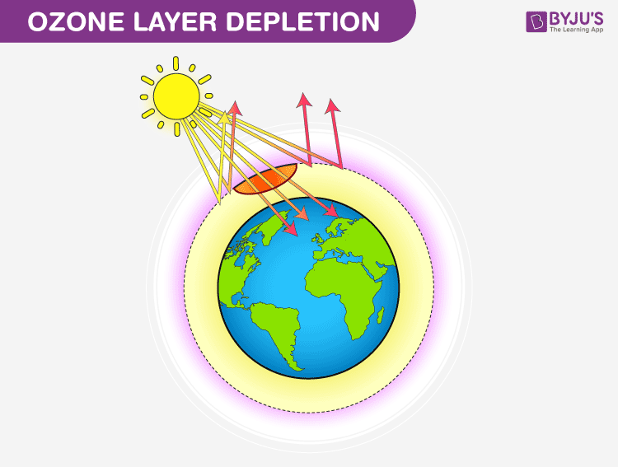


Slide 3
meaning
Ozone layer depletion is the thinning of the ozone layer present in the upper atmosphere.
The ozone layer or ozone shield is a region of Earth's stratosphere that absorbs most of the Sun's ultraviolet radiation.
Ozone or trioxygen, is an inorganic molecule with the chemical formula O_{3.} It is a pale blue gas with a distinctively strong smell.

Slide 4
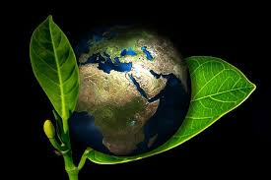
Why is Ozone Layer important?
Ozone protects the Earth from harmful ultraviolet (UV) rays from the Sun. Without the Ozone layer in the atmosphere, life on Earth would be very difficult. Plants cannot live and grow in heavy ultraviolet radiation, nor can the planktons that serve as food for most of the ocean life.

Slide 5
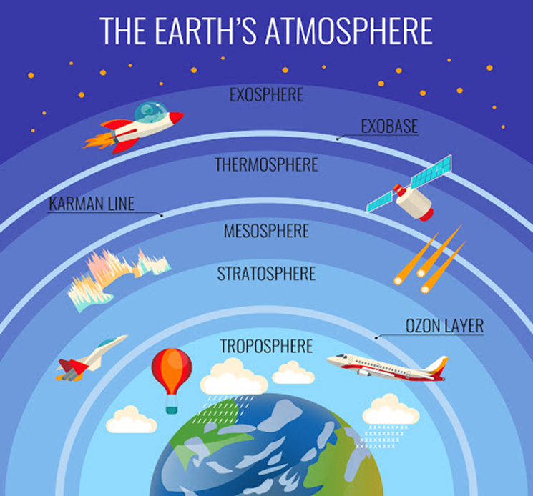

Slide 6
Causes of Ozone Layer Depletion
Chlorofluorocarbons-released by solvents, spray aerosols, refrigerators, air-conditioners, etc.
Unregulated Rocket Launches-Researches say that the unregulated launching of rockets result in much more depletion of ozone layer than the CFCs do
Nitrogenous Compounds-such as NO2, NO, N2O are highly responsible for the depletion of the ozone layer.
Natural Causes-processes such as Sun-spots and stratospheric winds

Slide 7
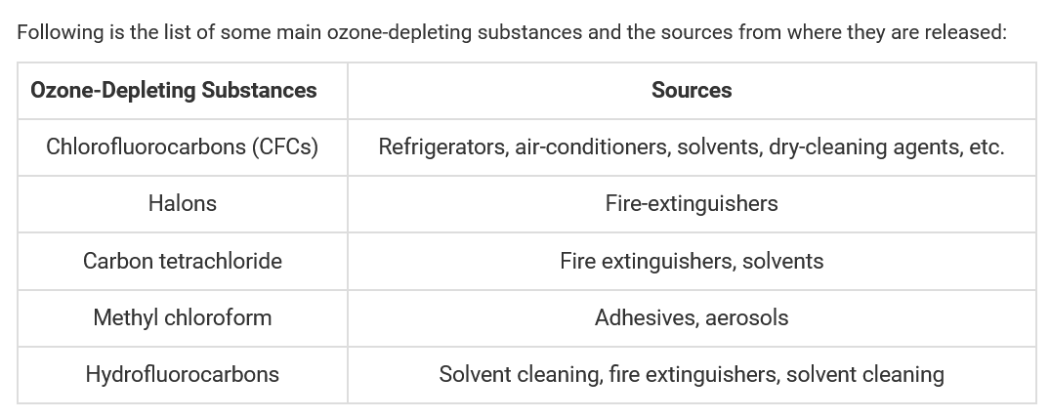

Slide 8
Effects Of Ozone Layer Depletion
Effects on Human Health-serious health issues among humans, such as skin diseases, cancer, sunburns, cataract, quick ageing and an weakened immune system
Effects on Animals-leads to skin and eye cancer in animals.
Effects on the Environment-Strong ultraviolet rays may lead to minimal growth, flowering and photosynthesis in plants.
Effects on Marine Life--the aquatic food chain, i.e Planktons are greatly affected.

Slide 9
Solutions to Ozone Layer Depletion
Avoid Using Pesticides- Natural methods should be implemented to get rid of pests and weeds instead of using chemicals.
Minimize the Use of Vehicles: The vehicles emit a large amount of greenhouse gases that lead to global warming as well as ozone depletion.
Use Eco-friendly Cleaning Products: Most of the cleaning products have chlorine and bromine releasing chemicals that find a way into the atmosphere and affect the ozone layer.
Use of Nitrous Oxide should be Prohibited: The government should take actions and prohibit the use of harmful nitrous oxide that is adversely affecting the ozone layer.

Slide 10
