Slide 1
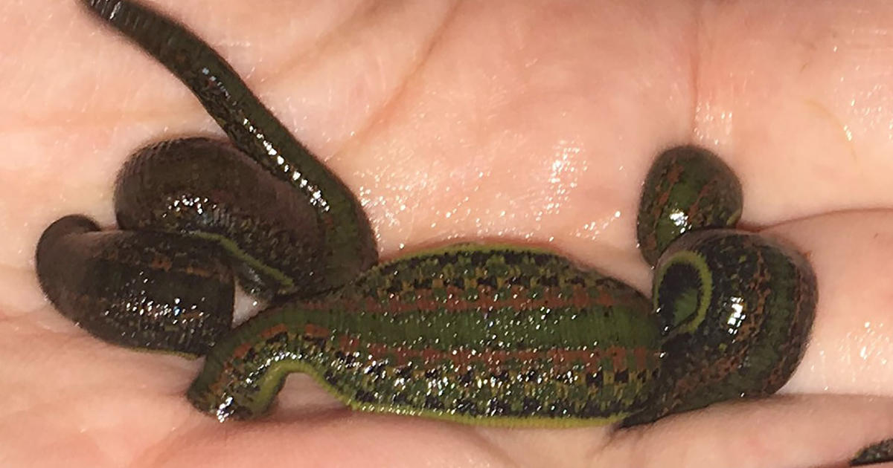
Excretion in annelida
Presented by saimoun

Slide 2
Excretion
Excretion is the removal of unwanted substances or metabolic wastes from body of an organism to the medium
Why is excretion essential ?
Excretion maintains the body”s homeostasis by the elimination of excess substances or metabolic by- product (toxic) that enter the body .

Slide 3
Excretory substances of annelids
-Ammonia
-Urea
-Amino acids
-water
-Different ions ,etc.

Slide 4
Excretory organs of Annelida
1.Primary excretory organs -
Nephridia
2.Secondary excretory organs –
Coelomoducts ,Chloragogen cells.

Slide 5
Coelomoducts
Mesodermal in origin ,developed from gonads, grow out and opens to the exterior by a genital pore.
Primarily function as gonoducts , but in some forms they may secondarily acts as excretory organs .

Slide 6
Nephridia
Nephridium is the primary excretory organ in annelida.
A pair of nephridia on each segment .
Ectodermal in origin ;developed from external surfaces ;grow into the body ;opens to the exterior by a nephridiopore .
The nephridia are lined with short , hair-like projections called cilia that beat repeatedly to maintain the flow of fluid through the organ .

Slide 7
Functions of Nephridia
Primarily serve for excretion .
Secondarily serve to convey the genital product to the exterior .

Slide 8
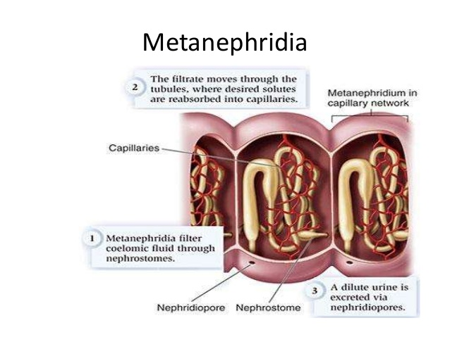

Slide 9
Types of Nephridia
Based on closed or open tubule-
1.Protonephridia 2.Metanephridia
Protonephridia :-Primitive type ; terminates in the coelom as blind tube i.e. closed ;terminates with peculiar specialized excretory flame cells/ solenocytes . eg. Nephridia of phyllodoce , vanadis etc.

Slide 10
Metanephridia :- Advanced type ;inner pre-septal end opens into coelom by a ciliated funnel ,nephrostomes ;no solenocytes. E.g. Nephridia of Lumbricus ,leeches etc.

Slide 11
PROTONEPHRIDIA
Excretory organs of larvae and adult polychaetes.
The protonephridial system have a tubular arrangement that open to the exterior through a nephridiopore.
These have tubes with blind ends where cilia mediated filtration occurs.
Two types of protonephridia are recognized based on its terminations –
1.Flame cells or cyrtocytes 2.Solenocytes

Slide 12
FLAME CELLS
The protonephridia whose blind ends terminate in flames cell.
These cells are bulb-like in appearance hence called flame bulbs.
These bears a cluster of cilia within the cup-like projection ,whose beating is like a candle flame.

Slide 13
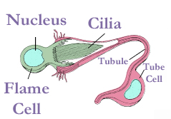

Slide 14
SOLENOCYTES
About 500 solenocytes in the nephridium.
Flagellated ;tiny rounded nucleated cell body and along hollow stalk or tubule.
Solenocyte can be distinguished from flames cells as the former is usually flagellated whereas the later is ciliated.
Associated with excretion ,osmoregulation and ionoregulation in many annelids.
Found in phyllodocids , alciopids and a few others.

Slide 15
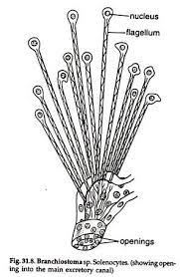

Slide 16
METANEPHRIDIA
Far advanced nephridia.
The inner end of the tubule may open into the coelom through a ciliated funnel , called nephrostome.
Found in oligochaetes(Lumbricus),polychaetes (Neathenes ),Leeches etc.

Slide 17
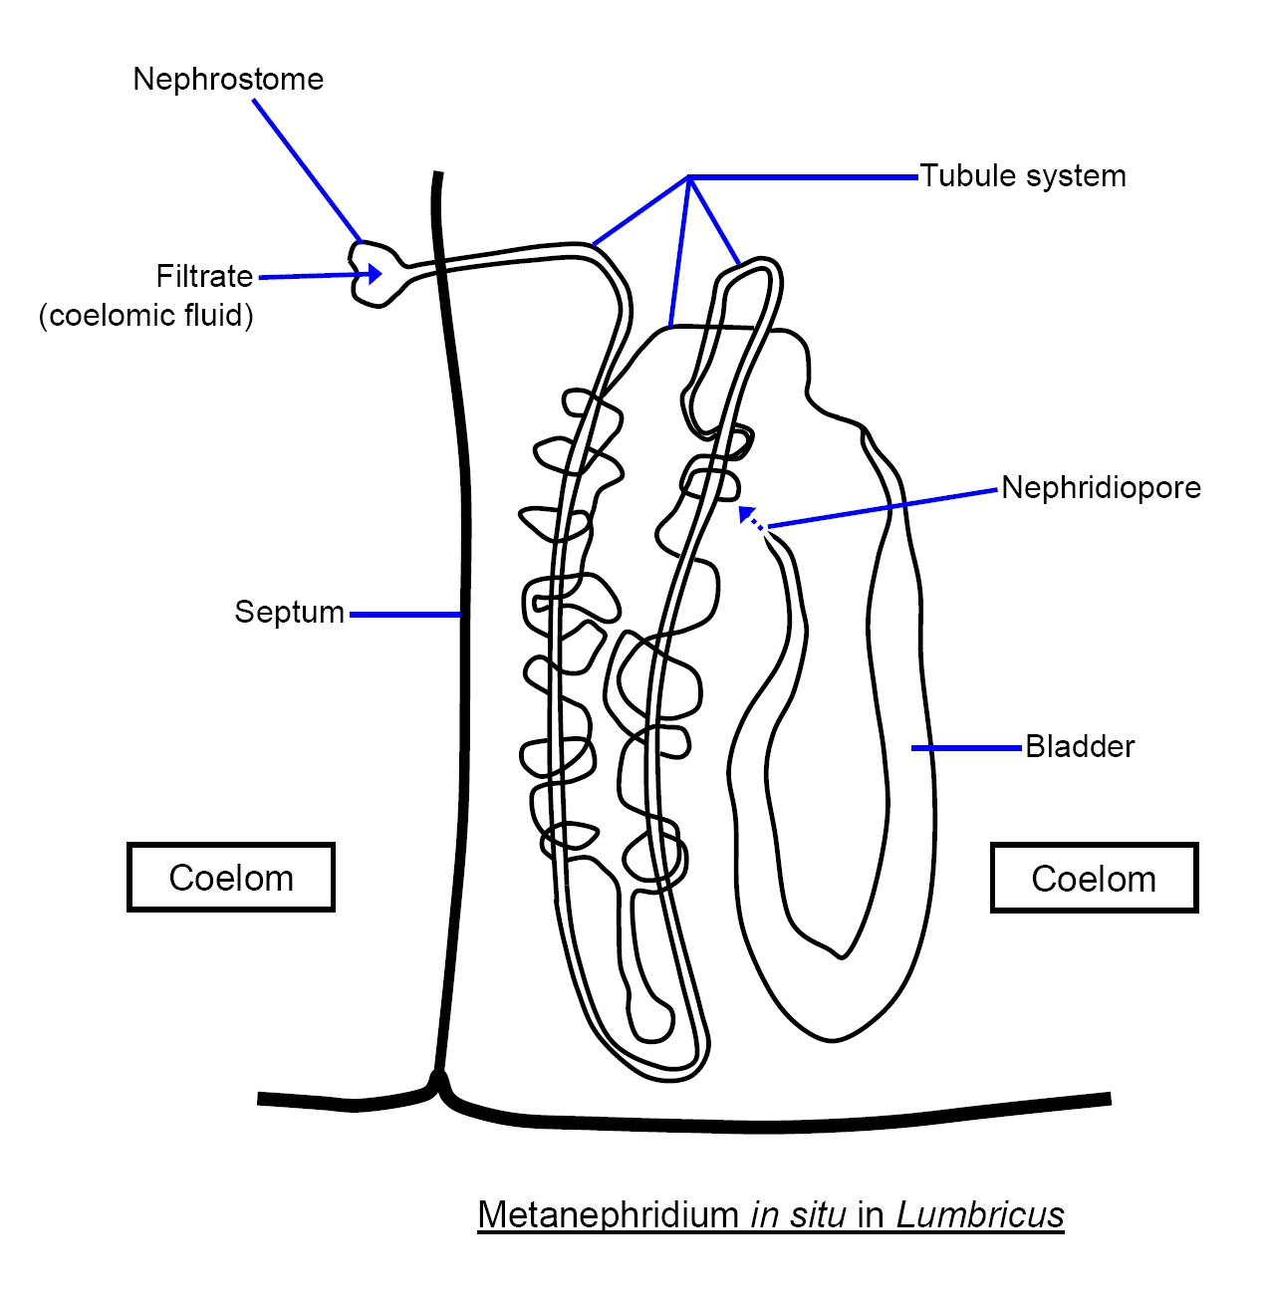

Slide 18
TYPES OF NEPHRIDIA –Based on size and number of nephridia –
1.Micronephridia or Meronephridia
2.Meganephridia or Holonephridia
Micronephridia | Meganephridia
Smaller in size , but numerous per segment. Networks of fine tubes lying on the body wall and septa in each segment. Example : Nephridia of Pheretima | 1.Larger in size ,but generally one pair per segment. 2.Usually extend over two segments and their nephrostomes open into the segments next in front. Example :Nephridia in Hirudinea

Slide 19
Types of nephridia :- Based on site of opening - 1. Exonephridia or ectonephridia
2. Enteronephridia
Exonephridia | Enteronephridia
1.Directly opens to the exterior. 2. Nephridiopores present . 3. Integumentary micronephridia of pheretima, meganephridia of nereis ,hirudinaria ,lumbricus etc. | 1.Opens to the excretory canals or alimentary canals. 2. Nephridiopores absent. 3.Septal and pharyngeal nephridia of pheretima.

Slide 20
CHLORAGOGEN
Star shaped and are also called as Y cells.
Derived from inner coelomic epithelium.
Yellowish in colour due to yellow granules ,chloragosomes.
Functions as liver in annelids.
They store and transport nitrogenous wastes, basically urea.

Slide 21
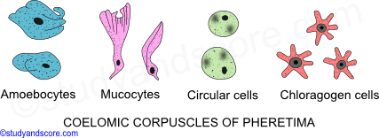

Slide 22
NEPHROMIXIA
Association of metanephridia with coelomducts .
A combination of mesoderm and ectoderm .
Compound segmental organs.
Serve for both Excretion and exit of gametes .

Slide 23
TYPES OF NEPHROMIXIA
Based on degree of combination these are following types :-
1.Protonephromixium
coelomduct+protonephridium,e.g. phyllodoce
2.Metanephromixium
coelomduct+metanephridium,e.g.Hesione
3.Mixonephromixium
coelomduct+Nephridium;e.g.Arenicola
4.Ciliated organs
coelomduct reduced to ciliated organs;e.g.Nereis

Slide 24
PHYSIOLOGY OF EXCRETION
1.Uptake of material /filtration from the blood.
2.Tubular reabsorption
3. Tubular secretion .
4.Expulsion from the body.

