Slide 1
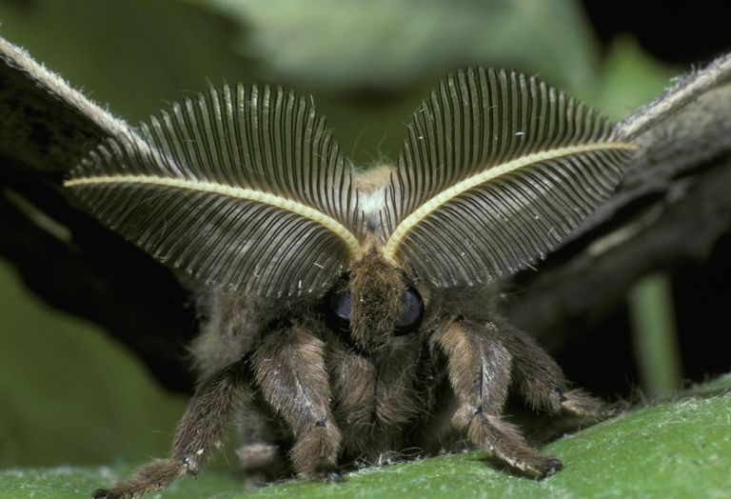
ANTENNAE OF INSECT
PRESENTED BY SAIMOUN

Slide 2
INTRODUCTION
It is also called feelers.
These are paired (except order protura)of highly mobile and segmented organ.
It is present behind and between the compound eyes in antennae socket .
The base of antennae is connected to socket by articulatory membrane which helps in its movement.

Slide 3
STRUCTURE AND FUNCTION

Slide 4
Antennae is made up of several segments and its basic structure in all the insects are same i.e. part antenna attached to socket is scape, then pedicel and the flagellum.
Scape is larger than pedicel and both having intrinsic muscles.
Each smaller segment of flagellum is called annuli.
Surface of flagellum have sensory receptors.
Size and form of flagellum varies in insects.

Slide 5
FUNCTIONS OF ANTENNAE
Helps to detect chemicals.
2.Perceives smell, humidity, temperature, vibrations ,wind velocity and direction.
3. In some insects like mosquitoes it helps in hearing and in ants it helps in communication and sometimes to catch prey .

Slide 6
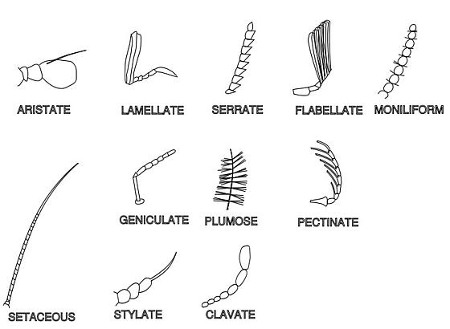
MODIFICATIONS OF INSECT ANTENNAE

Slide 7
1.ARISTATE
Aristate antennae are pouch like with a lateral bristle .
E.g. house and shore flies (order diptera )
2.CAPITATE
Capitate antennae are abruptly clubbed at the end.
E.g. Butterflies (order Lepidoptera )
3.CLAVATE
Clavate antennae are gradually clubbed at the end.
E.g. Carrion beetles (order coleoptera ).Adult carrion beetles feed on decaying animal matter or maggots.

Slide 8
4. FILIFORM
Filiform antennae have a thread like shape.
E.g. ground and longhorned beetles (order coleoptera ), cockroaches (order blattaria ) .
5.GENICULATE
Geniculate antennae are hinged or bent like an elbow.
E.g. Bees and ants (order Hymenoptera ).
6.LAMELLATE
Lamellate or clubbed antennae end in nested plates .
E.g. Scarab beetles (order coleoptera ) .
7.MONILIFORM
Moniliform have a beadlike shape .
E.g. Termites (order isoptera )

Slide 9
8.PECTINATE
Pectinate antennae have a comb like shape .
E.g. Fired colored beetles and fireflies ( order coleoptera )
9. PLUMOSE
Plumose antennae have a feather like shape.
E.g. Moths (order Lepidoptera) and Mosquitoes (order Diptera).
10. SERRATE
Serrate antennae have a saw toothed shape. E.g. Click beetles (order Coleoptera )

Slide 10
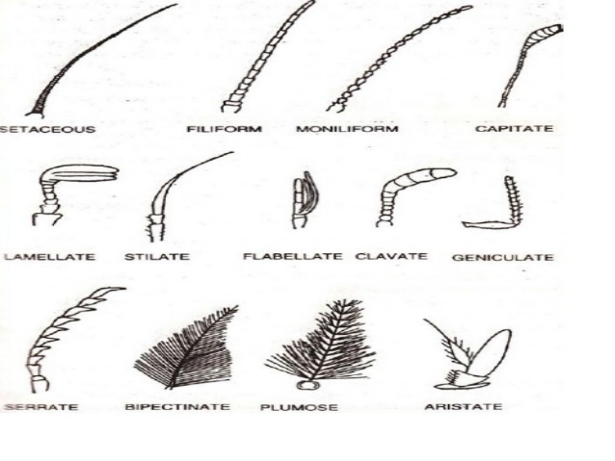
11.SETACEOUS
Setaceous antennae have a bristle like shape .
E.g. Dragonflies and damselflies (order Odonata).

Slide 11
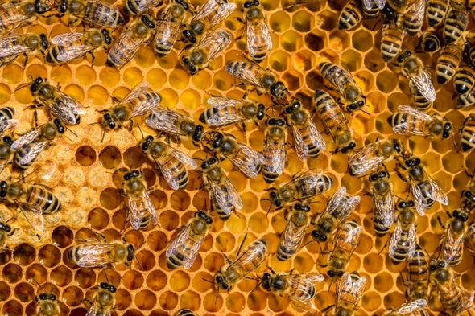
THANKS YOU

