Slide 1
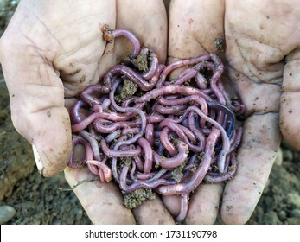
GENERAL CHARACTERISTICS OF PHYLUM ANNELIDA
PRESENTED BY SAIMOUN

Slide 2
INTRODUCTION
Phylum annelida was first coined by Lamarck .
ANNELIDA( annelus –little ring , eidos –form )
They are elongated , bilaterally symmetrical and highly organized animals .
Appearance of metamerism represents their greatest advancement , so that they are called segmented worms .

Slide 3
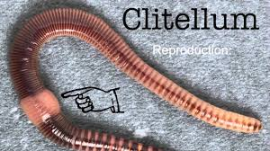
GENERAL CHARACTERS
HABITAT
Mostly aquatic,some terrestrial,burrowing ,some commensal and parasitic .

Slide 4
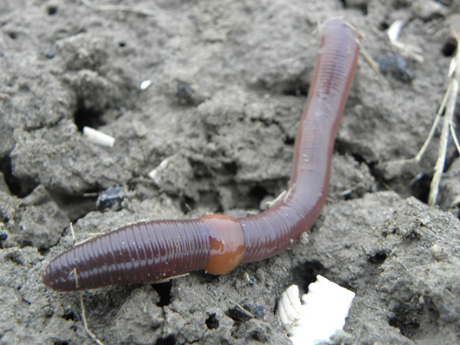
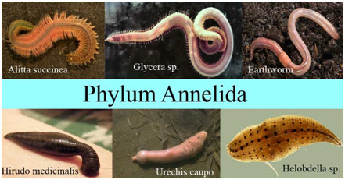

Slide 5
Shape,symmetry and coelom
Body elongated , bilateral symmetrical, triploblastic ,truly coelomate and metamerically segmented into similar metameres.

Slide 6
OUTER COVERING
Epidermis of a single layer of columnar epithelial cells , covered externally by a thin cuticle not made of chitin .
Body wall dermo muscular . Outer muscle fibres circular , inner longitudinal .

Slide 7
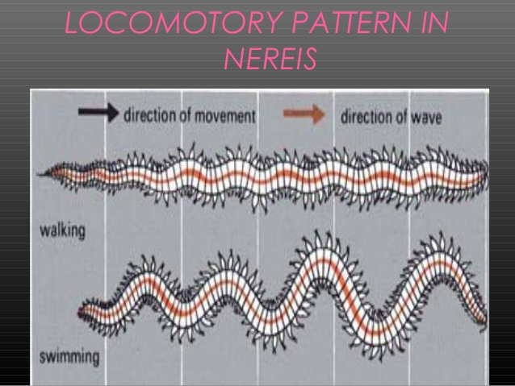
LOCOMOTORY ORGANS

Slide 8
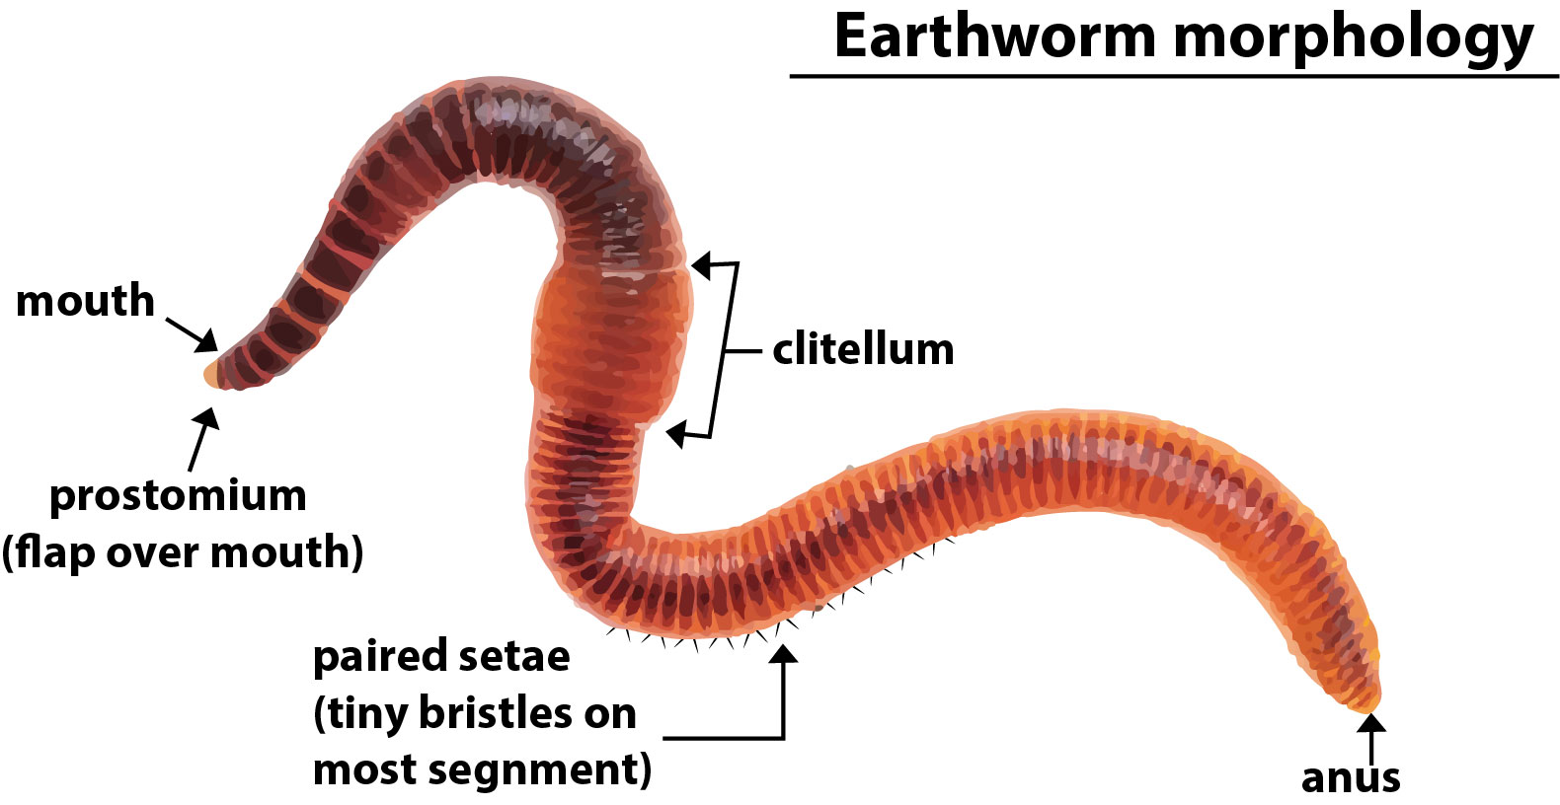

Slide 9
LOCOMOTORY ORGANS
Parapodia present in some groups .
One or many pairs of chitinous bristles called setae (chaetae).
Function :
Morphology needs for classification .
Highly vasculized – exchanged of gases .
Locomotory function .

Slide 10
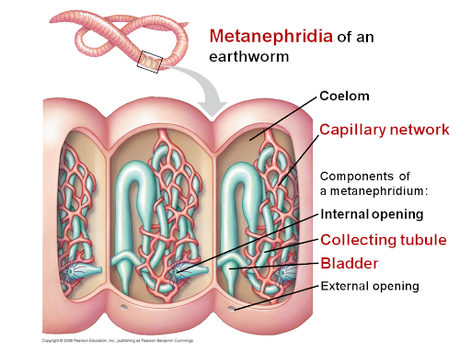
EXCRETORY SYSTEM

Slide 11
Excretory systems consisting of metemerically disposed coiled tubes ,called nephridia / metanephridia .
It is a little kidney .
Each segment contains 2 nephridia .
Each opens at both ends with 2 openings .
Ciliated funnels called nephrostomes that removes wastes from the blood and coelomic fluids.

Slide 12
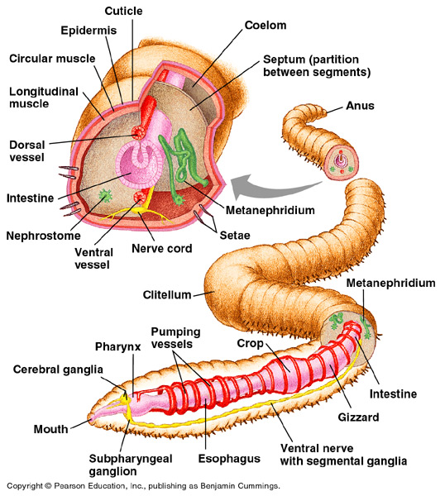
DIGESTIVE SYSTEM

Slide 13
Complete compartmentalized digestive system in most groups: mouth , pharynx ,esophagus ,intestine , rectum , anus .
Pharynx is associated with salivary glands (that secrete hirudin anticoagulant in hirudinea ).
Esophagus may lead to a crop then giggard and associated with calciferous glands for control of Ca ion concentration in oligochaeta .

Slide 14
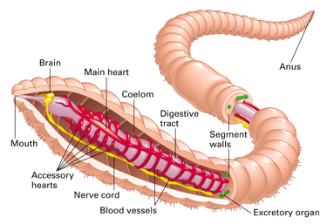
CIRCULATORY SYSTEM

Slide 15
Circulatory system closed type .
It consist of dorsal blood vessel (carriying blood towards posterior end ) and ventral blood vessel (carrying blood towards posterior end ).
Contraction of blood vessels and valves ensure circulation and movement of blood in one direction .
Blood pigment mostly hemoglobin but some polychaeta have chlorocruorin or hemoerythrin as a blood pigments (both Fe containing pigments).
Circulatory system much reduced or absent in hirudinea with coelomic fluid used for circulation .

Slide 16
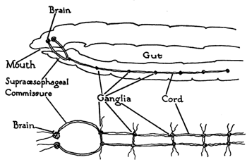
NERVOUS SYSTEM

Slide 17
Cerebral ganglia (brain) located above buccal cavity .
Connected to a subpharyngeal ganglion .
And a series of ventral segmental ganglia running throughout the body .
Sense organs include :Touch receptors (tentacles and palps) ,statocysts , photoreceptors ,mechanoreceptor(vibration), chemoreceptors that include ciliated slit

Slide 18
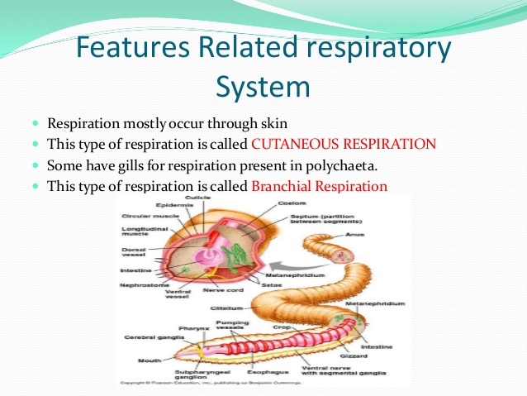
RESPIRATORY SYSTEM

Slide 19
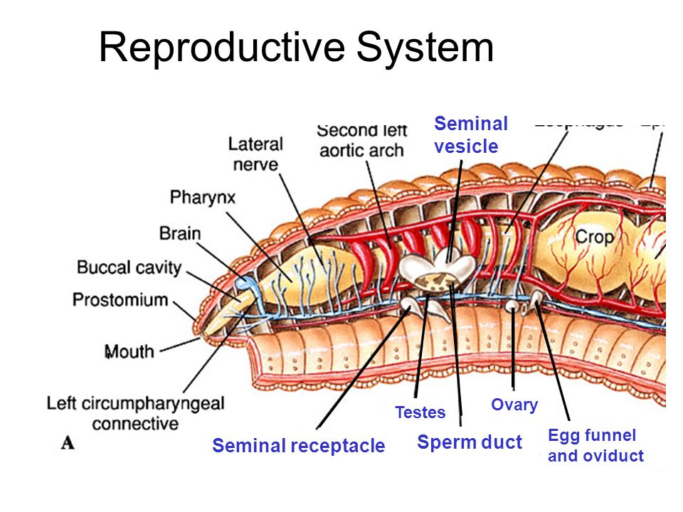
LIFE CYCLE

Slide 20
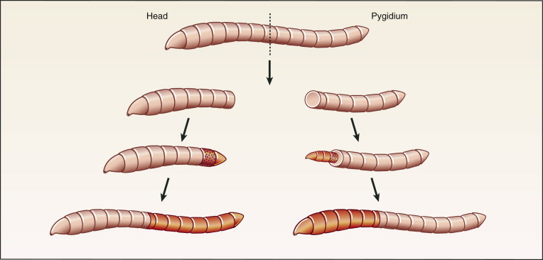

Slide 21
Hermaphroditic .Regeneration common.

Slide 22
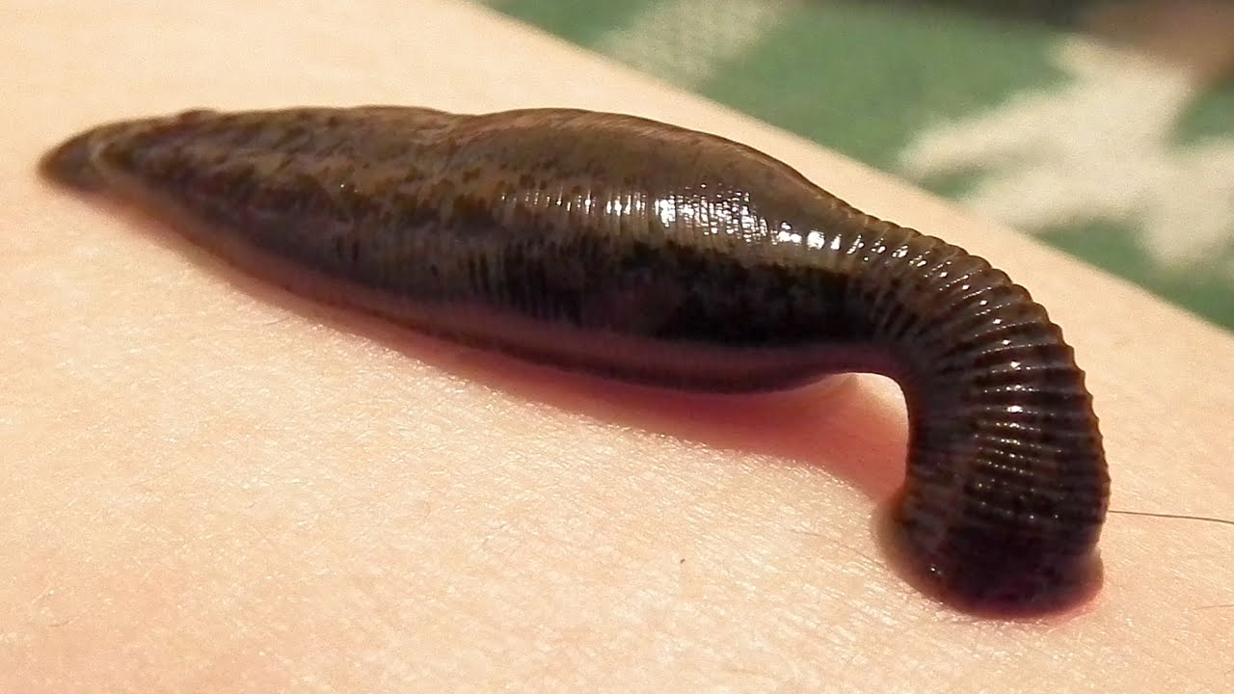
THANK YOU
GOOD LUCK
MY BEST WISHES ARE WITH YOU

