Slide 1
Topic: Causes of Inflation
Paper: Introductory Macroeconomics
Unit: 4
Prepared by
Anindita Chakravarty

Slide 2
There are two main causes of inflation
Both are responsible for a general rise in prices in an economy
But they work differently.
Demand-pull conditions occur when demand from consumers pulls prices up.
Cost-push occurs when supply cost force prices higher.
Demand Pull
Cost Push

Slide 3
Demand-Pull Inflation
Demand-pull inflation is the most common cause of rising prices.
It occurs when consumer demand for goods and services increases so much that it outstrips supply.
Producers can't make enough to meet demand.
There are several circumstances that create demand-pull inflation.
  A growing economy affects inflation because when people get better jobs, they spend more.
  A discretionary fiscal policy- government either spends more or taxes less.
  Over-expansion of the money supply- not just cash, but also credit, loans, and mortgages.

Slide 4
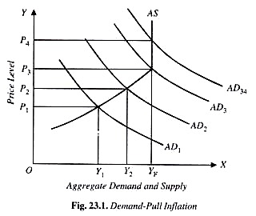
Full-employment level of aggregate supply OY_{F} is reached, aggregate supply curve AS takes a vertical shape.
This is because after the level of full employment, supply of output cannot be increased.

Slide 5
EXPLANATION NOTE OF DIAGRAM
Consider the Fig in which aggregate demand and aggregate supply are measured along the X-axis and general price level along the Y-axis. Curve AS represents the aggregate supply which rises upward in the beginning but when full-employment level of aggregate supply OY_{F} is reached, aggregate supply curve AS takes a vertical shape.
When aggregate demand curve is AD₁ the equilibrium is at less than full- employment level where price level OP₁ is determined.
Now, if the aggregate demand increases to AD₂, price level rises to OP₂ due to the emergence excess of demand at price level OP₁. It will be noticed that here the rise in price level has also brought about increase in aggregate output supplied from OY₁ to OY₂.
If the aggregate demand further increases to AD₃, the price level rises to OP₃ under the pressure of more demand.
But since he aggregate supply curves is yet sloping upward, increase in aggregate demand from AD₂, to AD₃ has -used the increase in output from OY₂ to OY_{F}
If aggregate demand further increases, say to AD₄ only price level raises to OP₄ with output remaining constant at YF. OY_{F} is the full-employment level or output and aggregate supply curve is perfectly inelastic at Y_{F}.

Slide 6
In the next class, we will continue with Cost-push inflation
THANK YOU

