Slide 1
Fungal Nutrition
Dr. Lipika Lahkar
Assistant Professor
Department of Botany
Silapathar College

Slide 2
supply of nutrients is essential for every living organism because the nutrients serve as structural units and also as source of energy
Nutrition is the process of procuring nourishment or nutrient and is the principle function of mycelium
Nutritional requirements
Due to lake of chlorophyll the fungi are unable to photosynthesize
utilize both organic compounds and inorganic materials
heterotrophic in nutrition and obtain food materials by living as saprophytes or parasites

Slide 3
The basic nutritional need of fungi are
A sweetable organic compound as a source of carbon and energy
A sweetable source of nitrogen
Inorganic ions of sulphur, phosphorus, potassium and magnassium in significant amount - macro nutrients, inorganic ions of iron, zinc, copper, molebdenum- minute traces micro nutrients
Certain vitamins or organic growth factor in trace amount

Slide 4
A sweetable organic compound as a source of carbon and energy
Yeast can use acetates as a souece of carbon
carbohydrates are needed for building up the body and also as a source of energy
most fungi use simple sugar (glucose) as the source of carbon
fructose is also sweetable for some fungi
some fungi utilize pentose sugar like xylose
Some fungi use mannitol
Some fungi utilized maltose by product of starch
Sucrose is also a good source of food
Few fungi utilized polysaccharide like starch and cellulose
fats which is the source of carbon
proteins, lipids, some organic acid and some higher alcohol utilized by some fungi

Slide 5
2. A sweetable source of nitrogen
besides carbon fungi require nitrogen they obtain nitrogen from organic and inorganic materials
source of nitrogen are organic and inorganic are protein, peptide or amino acid
In mature fungi decompose protein and other materials to obtain their supply of nitrogen
In pure culture amino acids, peptides of pepton, jelatin, casein and egg albumin can serve as sources of organic nitrogen for building up protoplasm
Some fungi utilize urea as the source of nitrogen
fungi use both nitrate and ammonia salts as the source of nitrogen

Slide 6
3. Inorganic ions of sulphur, phosphorus, potassium and magnassium in significant amount- macro nutrients, inorganic ions of iron, zinc, copper, molebdenum- minute traces micro nutrients
The chief inorganic nutrients which the fungi required in large amount for their mineral nutrition S,P,K,Mg
These are the macro nutrients, the fungi obtain from simple inorganic forms or sources such as sulphates for sulphur, phosphate for phosphorus
Some fungi require only minute traces of Fe, Zn, Cu, Mn, Co and Mb
These are the micronutrients which are considered essential for growth of fungi.

Slide 7
4. Certain vitamins or organic growth factor in trace amount
The fungi require minute amounts of specific relatively complex organic compounds for their growth these are the vitamins or growth factors
Many fungi synthesized their own supply of appropriate growth factor, called as auxo-autotrophic
The fungi which are heterotrophic for their needs of growth factor aexotrophic
The important fungal vitamins which may function in enzyme system includes thiamine (B₁), Biotin, Pyredoxin (B₆) and riboflavin (B₂)
few fungi also need nicotinic acid and pantothenic acid

Slide 8
Water and oxygen are also the nutrients which are supplied in the form of water. Water is the major constituent of fungus mycelium forming about 82-90% of the entire weight.
Besides the nutritional requirement mentioned above the growth of fungi is influence by habitate factor, temperature supply, moisture, P^{H} value and by products of metabolism.

Slide 9
Mechanism of Nutrition in Fungi

Slide 10
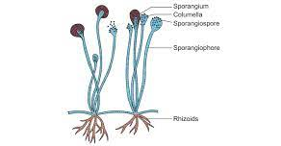
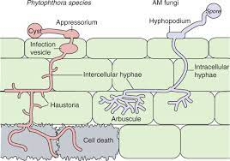
Mechanism Of Nutrition
Rhizoids penetrating substratum
Intercellular and Intra cellular hyphae

Slide 11
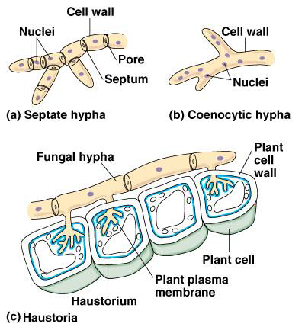

Slide 12
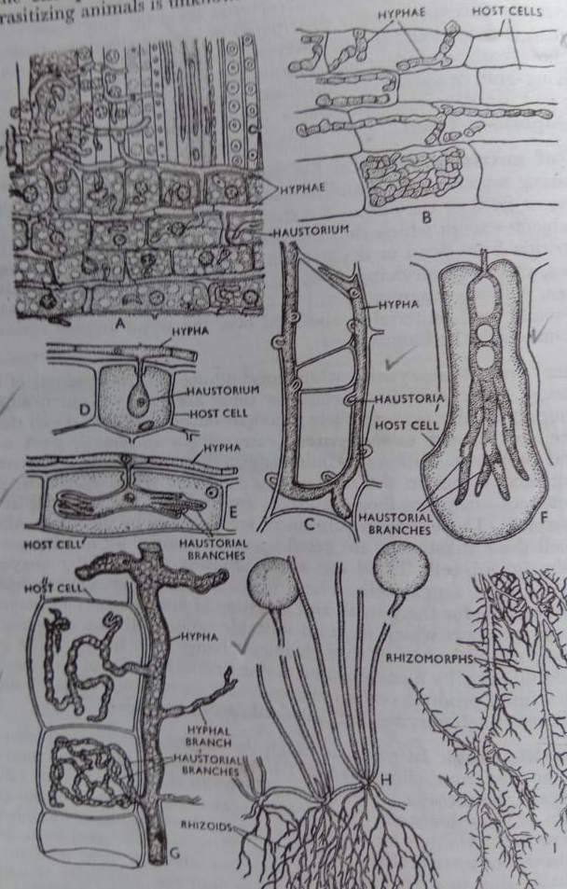
A . Intercellular hyphae,
B- Intra cellular hyphae,
C-G- Various types of hyphae,
H- Rhizoids penetrating substratum
I- Rhizomorphs

