Slide 1

Mathematical Methods for Economics - II
ECNHC202
UNIT: 2
Linear Algebra (Matrices and Determinants)

Slide 2
Matrices
  Matrices are the ordered rectangular array of numbers, which are used to express linear equations.
  A matrix has rows and columns and we can also perform the mathematical operations on matrices such as addition, subtraction, multiplication of matrix.
  Suppose the number of rows is m and columns is n, then the matrix is represented as m × n matrix.

Slide 3
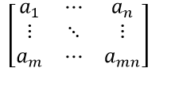
MATRIX

Slide 4
Determinants
Determinant, in linear and multilinear algebra, a value, denoted A, associated with a square matrix A of n rows and n columns.
Designating any element of the matrix by the symbol a_{rc} (the subscript r identifies the row and c the column)
The determinant of a 1×1 matrix is that number itself.

Slide 5
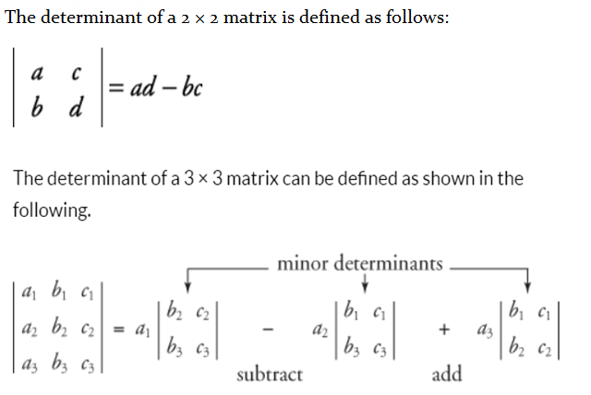

Slide 6
Differences between determinant and matrix
In a matrix, the set of numbers are covered by two brackets whereas, in a determinant, the set of numbers are covered by two bars.
The number of rows need not be equal to the number of columns in a matrix whereas, in a determinant, the number of rows should be equal to the number of columns.

Slide 7
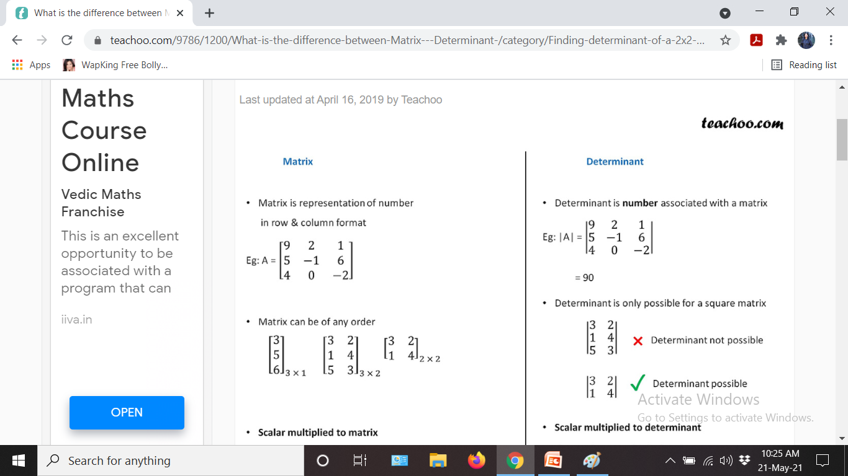

Slide 8
THANK YOU
STAY SAFE
STUDY HARD

