Slide 1
Plant Physiology and Metabolism
Generic Elective
Second semester
Paper- GE2
Credits: Theory-4, Practical-2
Paper Evaluation
2 internal assesment, 1 group discussion
DR. Lipika Lahkar
Assistant professor
Silapathar college

Slide 2
Units
1
(8 lectures)
2
(8 lectures)
3
(6 lectures)
Plant-water relations
Mineral nutrition
Translocation in phloem
9
(6 lectures)
Plant response to light and temperature
Plant Physiology and Metabolism
Photosynthesis
4
(12 lectures)
Plant growth regulators
Respiration
Nitrogen metabolism
Enzymes
8
(6 lectures)
5
(6 lectures)
7
(4 lectures)
6
(4 lectures)

Slide 3
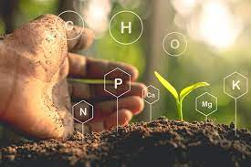
Unit 1: Plant-water relations (8 lectures)
Unit 2: Mineral nutrition (8 lectures)
Unit 3: Translocation in phloem (6lectures)

Slide 4
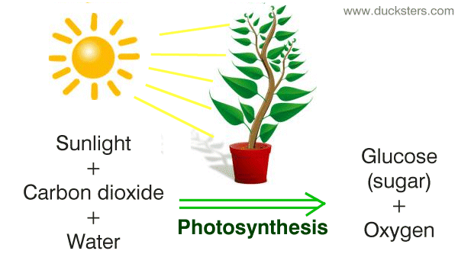
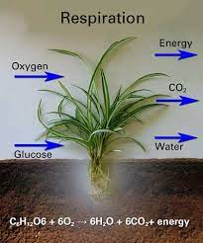
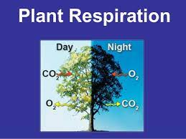
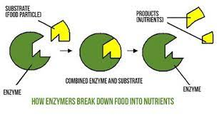
Unit 4: Photosynthesis (12 lectures)
Unit 5: Respiration (6 lectures)
Unit 6: Enzymes (4 lectures)

Slide 5
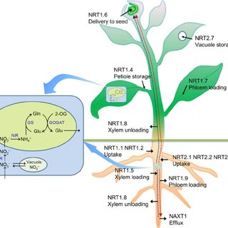
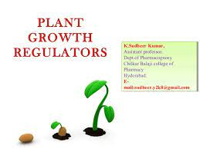
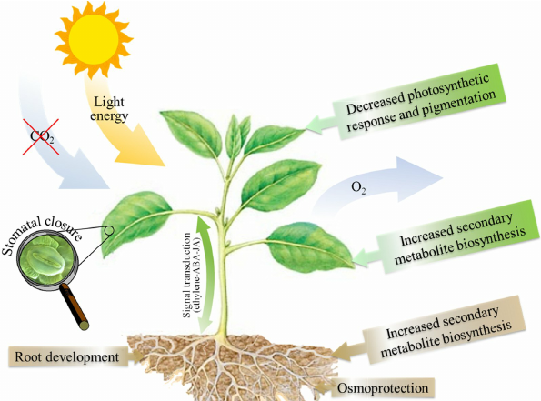
Unit 7: Nitrogen metabolism
Unit 8: Plant growth regulators
Unit 9: Plant response to light and temperature

